Slide 1



Lecture-15
Data Structures
Binary Trees
Kartik Mathur

Slide 2
Any Doubts?
2

Slide 3
Binary Trees
3

Slide 4
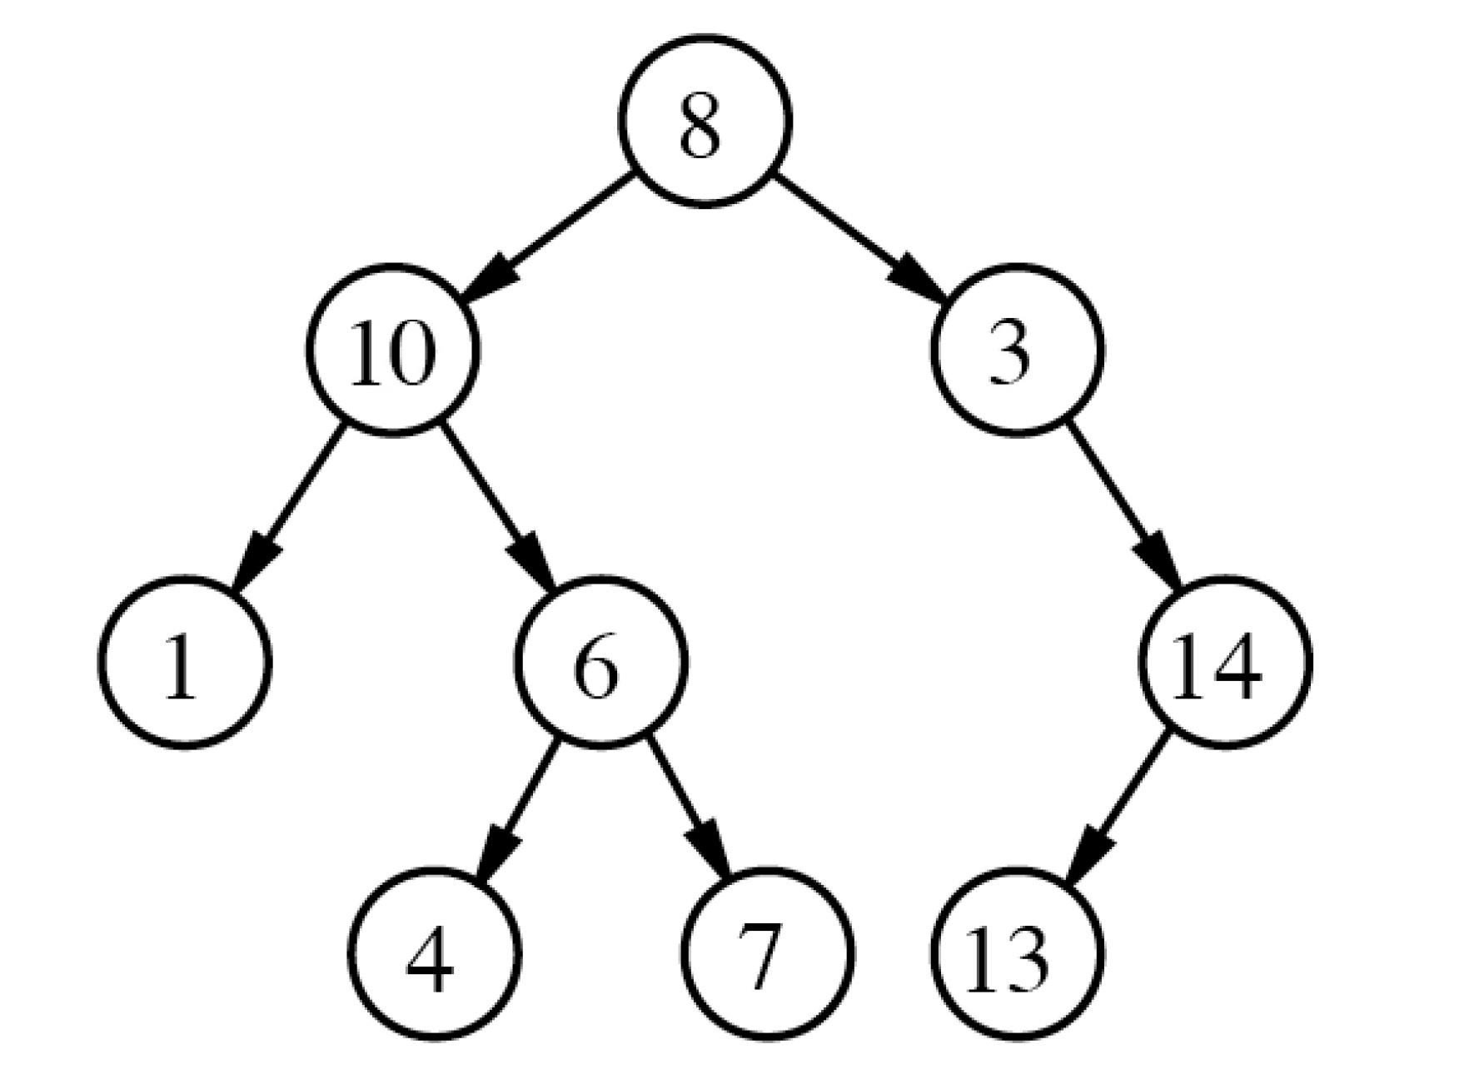
Binary Trees
4

Slide 5


Binary Tree Node
5
class node{ int data; node* left; node* right;
}

Slide 6
Input & Output
6
Take Input
Print

Slide 7
Lets discuss a problem
7
Count number of Nodes
Height of the tree
Find diameter of a binary tree
Max Sum Problem by taking either child or parent node in the sum

Slide 8
Your Turn
8
Find a node in Binary Tree
Mirror a binary tree

Slide 9
Another Traversal for Binary Trees
9
Inorder Traversal
Preorder
Postorder
LevelOrder
More Questions…

